Slide 1
Stack in 8085

Slide 2
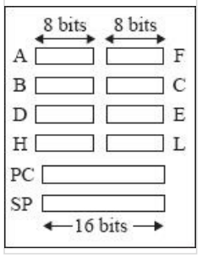
Programmer's view of 8085

Slide 3
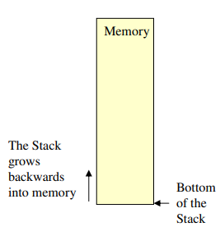
Introduction to Stack
The stack is a reserved area of the memory (identified by the programmer) where we can store temporary information.
The stack is a LIFO structure.
The stack normally grows backwards into memory.

Slide 4
How does a stack work in assembly language?
The 8085 provides two instructions: PUSH and POP for storing information on the stack and retrieving it back.
– Both PUSH and POP work with register pairs ONLY.

Slide 5
Operation of the Stack
During pushing, the stack operates in a decrement then store style.
During poping, the stack operates in a use then increment style.
The SP pointer always points to the top of the stack.

Slide 6
LIFO
The order of PUSHs and POPs must be opposite of each other in order to retrieve information back into its original location.
PUSH B
PUSH D
...
POP D
POP B

Slide 7
The PUSH Instruction
PUSH B (1 Byte Instruction) Rp
Decrement SP
Copy the contents of register B to the memory location pointed to by SP
Decrement SP
Copy the contents of register C to the memory location pointed to by SP
B C
12
F3
F3
12
FFFB FFFC FFFD FFFE FFFF
SP

Slide 8
The POP Instruction
POP D (1 Byte Instruction)
Copy the contents of the memory location pointed to by the SP to register E
Increment SP
Copy the contents of the memory location pointed to by the SP to register D
Increment SP
D
E
12
F3
F3
12
FFFB FFFC FFFD FFFE FFFF
SP

Slide 9
Saving Information on the Stack
There are two methods to add data to the stack:
Direct method
Indirect method

Slide 10
Saving Information on the Stack
Direct method
the stack pointers address is loaded into the stack pointer register directly LXI SP,8000H LXI H,1234H PUSH H POP D HLT

Slide 11
Saving Information on the Stack
Indirect method
the stack pointer’s address is loaded into the stack pointer register via another register pair. LXI H,8000H SPHL LXI H,1234H PUSH H POP D HLT

Slide 12
PSW Register Pair
The 8085 recognizes one additional register pair called the PSW (Program Status Word).
– This register pair is made up of the Accumulator and the Flags registers.
It is possible to push the PSW onto the stack, do whatever operations are needed, then POP it off of the stack.

Slide 13
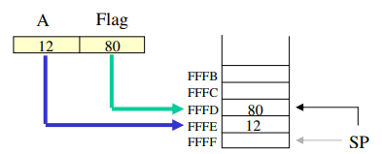
PUSH PSW Register Pair
PUSH PSW (1 Byte Instruction)
– Decrement SP
– Copy the contents of register A to the memory location pointed to by SP
– Decrement SP
– Copy the contents of Flag register to the memory location pointed to by SP

Slide 14
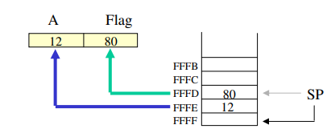
Pop PSW Register Pair
POP PSW (1 Byte Instruction)
– Copy the contents of the memory location pointed to by the SP to Flag register
– Increment SP
– Copy the contents of the memory location pointed to by the SP to register A
– Increment SP

Slide 15
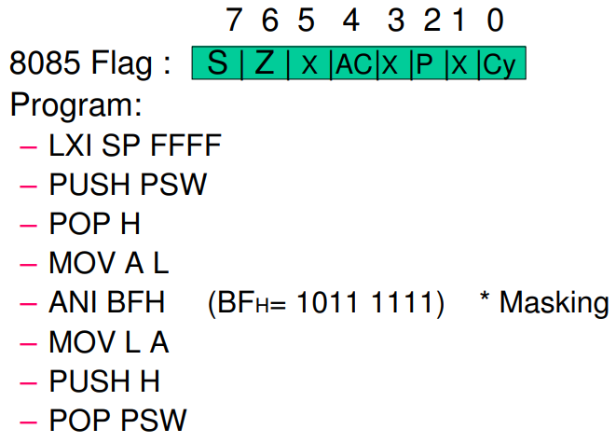
Modify Flag Content using PUSH/POP
We want to Reset the Zero Flag

